Slide 1

UI DESIGN AND IMPLEMENTATION
Presentation By
GROUP 3
CEF440 - Internet & Mobile Programming
Instructor - Dr Valery Nkemeni
Academic Year: 2024/2025

Slide 2
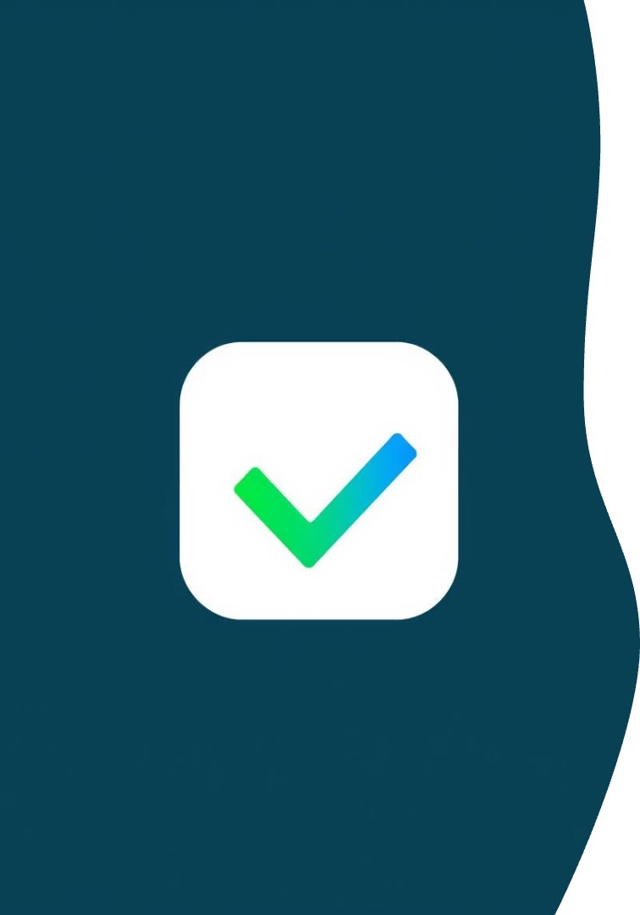





App Identity: Checkin
App Name
Tagline
Logo
Checkin: Monitors Quality of Experience (QoE) for mobile networks.
"Empower Your Connection" emphasizes user control and transparency.
A signal bar merged with a checkmark, symbolizing reliable monitoring.
Color Scheme
Deep green (#2E7D32) for trust, vibrant blue (#1565C0) for tech, bright amber (#FFD54F) for alerts.

Slide 3




Target Audience & Tone
Mobile Users
Network Operators
Regulatory Authorities
Subscribers tracking and reporting network performance.
Staff needing aggregated reports for diagnostics and improvements.
Entities requiring anonymized data for compliance and monitoring.
The app maintains a professional, user-friendly, and transparent tone to build trust and encourage interaction.

Slide 4
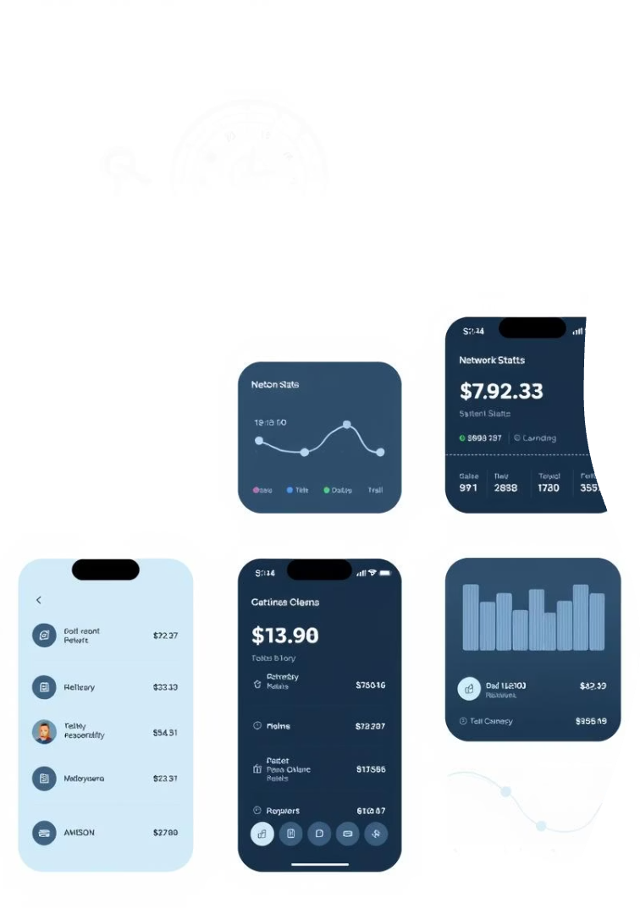
Visual Design Principles
Clarity
Simple layouts and intuitive navigation for easy feedback and settings.
Consistency
Uniform colors, fonts, and iconography across all screens for a cohesive experience.
Accessibility
High-contrast colors, scalable text, and screen reader support for WCAG 2.1.
Responsiveness
Adaptive design for various screen sizes using React Native.

Slide 5
Key Screens & Layouts
Dashboard
Feedback Form
Report History
Settings & Alerts
Displays real-time network stats (speed, latency, signal strength).
Allows users to report network issues with ratings, comments, and optional screenshots.
Shows past feedback submissions and their status in a scrollable list.
Manages user preferences and notifies users of network issues.
Features visual cards and quick action buttons.

Slide 6

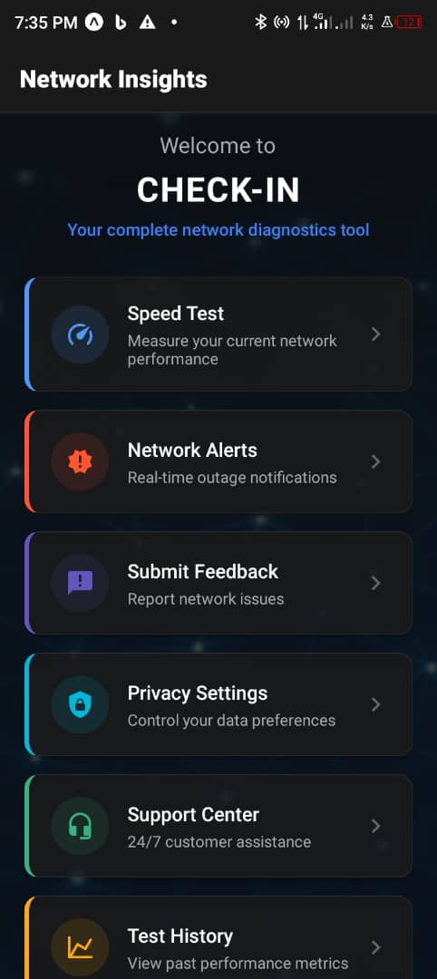




Frontend Technology Stack
React Native
Cross-platform mobile app development for code reuse.
Redux
Manages network stats, user feedback, and settings.
i18n Library
Supports language localization (English, French).
RESTful API
Integrates with Cloud Server for data and notifications.

Slide 7

Conclusion
The Checkin app prioritizes user-friendly navigation and clear visual feedback.
Its robust frontend, built with React Native, ensures a scalable and secure solution.

